Slide 1

Project Title -Healthcare Analytics for Doctor Visits
Student name- Vaibhav Sharma
STU6a66c7a4c9dcd1785120676

Slide 2

PROBLEM STATEMENT
Project uses Python, Pandas, and data visualization to analyze doctor visit patterns. It explores how illness, health status, age groups, and chronic conditions are associated with healthcare utilization. The insights help hospital management understand patient needs and identify opportunities to improve healthcare services.

Slide 3
Project Description
This project uses Python, Pandas, and data visualization techniques to analyze doctor visit patterns in a healthcare dataset. The analysis explores how demographic, socioeconomic, and health-related factors such as age, gender, illness, reduced activity, and health status are associated with doctor visits. The project applies exploratory and multivariate analysis to identify meaningful patterns and relationships in healthcare utilization. The findings provide a descriptive understanding of factors associated with doctor visits while recognizing that the observed relationships do not establish causation.

Slide 4

WHO ARE THE END USERS?
Hospital Management – to understand doctor-visit patterns and patient healthcare utilization.
Healthcare Administrators – to support planning and resource allocation.
Doctors & Healthcare Providers – to understand patterns related to illness,
health status, and healthcare visits.

Slide 5

Technology Used
Python – Data analysis and processing
Pandas – Data loading, cleaning, grouping, and statistical analysis
NumPy – Numerical operations
Matplotlib – Data visualization
Seaborn – Statistical charts and visualizations
Jupyter Notebook – Analysis environment and documentation

Slide 6
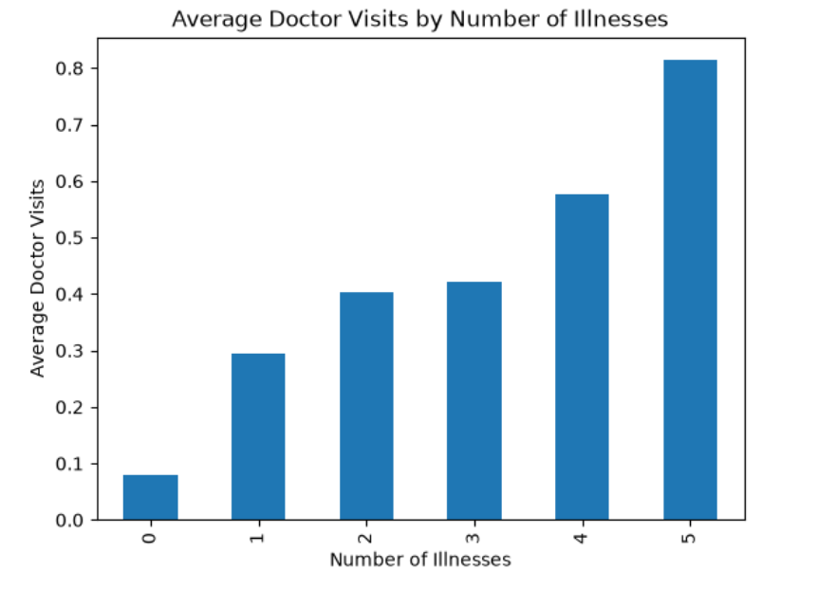
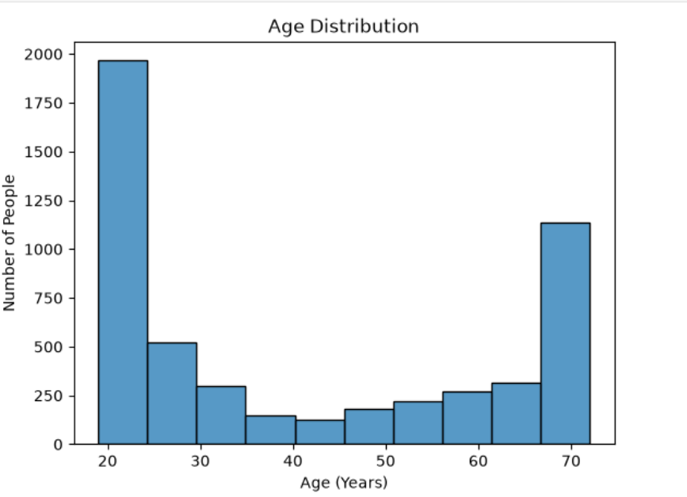
RESULTS

Slide 7
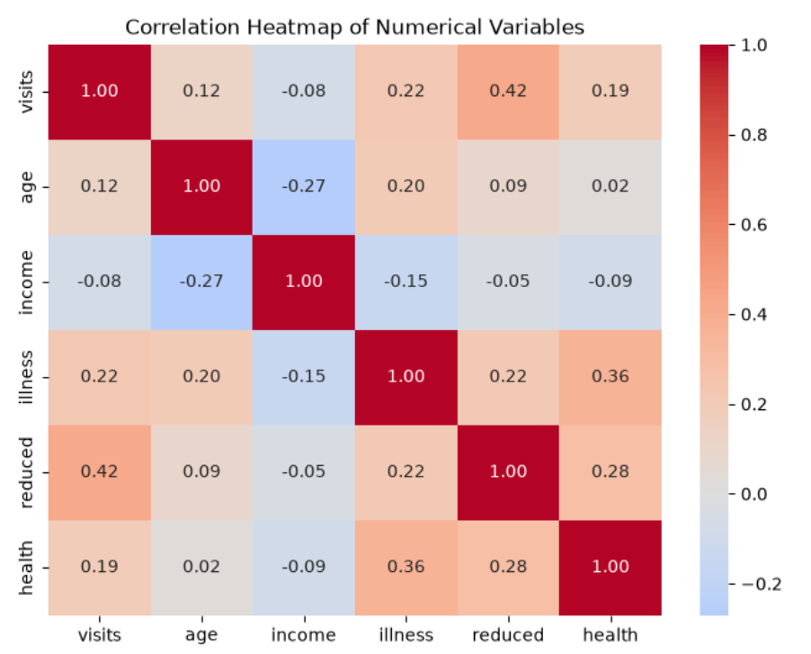
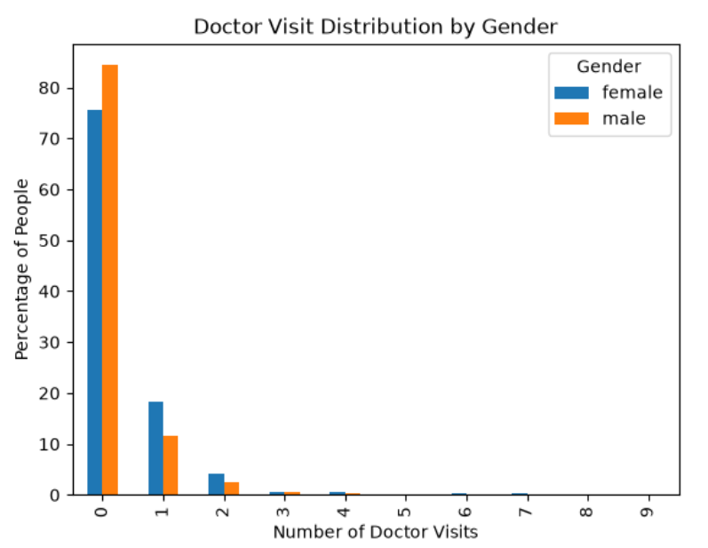
RESULTS

Slide 8
RESULTS
Doctor visits: 4,141 out of 5,190 observations recorded 0 doctor visits, showing that visits were highly concentrated at zero.
Gender: Females had a lower proportion of zero visits (75.57%) than males (84.36%).
Age: The analysis did not show a clear linear relationship between age and doctor visits.
Illness: Average doctor visits generally increased as the number of recorded illnesses increased, from 0.079 visits for 0 illnesses to 0.814 visits for 5 illnesses.
Reduced activity: Days of reduced normal activity had the strongest positive linear association with doctor visits among the numerical variables examined (r = 0.42)
https://github.com/VaibhavSharma2627/Healthcare-Analytics-for-Doctor-Visits

Slide 9
Thank you
.
.

